Slide 1
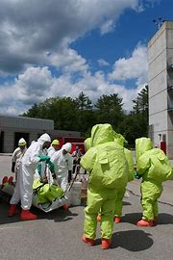
Welcome to LEPC/TEPC 102 Please enter your Name, Organization and the LEPC or Tribe you’re affiliated with in the chat.
Notes:
Welcome, we will get started in a few minutes. Please enter your Name and LEPC or Tribe you’re associated with in the chat. This will be an interactive discussion and we will encourage participation. However, please keep your camera off and microphone muted until it’s time to contribute. Also, this presentation will be recorded for future use.

Slide 2
Washington State LEPC/TEPC 102
National LEPC-TEPC Handbook | US EPA
Notes:
Welcome. This presentation, entitled Washington State Local Emergency Planning Committee (LEPC) / Tribal Emergency Planning Committee (TEPC) 102, is intended for LEPC and TEPC members who would like more information on meeting the administrative aspects of the Emergency Planning and Community Right-to-know Act (EPCRA). It is presented by SERC support staff.
Please keep your microphone muted and video turned off unless you are speaking. Feel free to use the raise hand or chat function at any time during the presentation to ask questions and make comments. This is an interactive presentation, and your questions and comments are welcome. Please enter your name, LEPC or Tribe you are affiliated with in the chat. Please be aware that this presentation will be recorded for future use and will be made available. Also, after we finish today, please fill out the survey to help improve future presentations.
For those of you that missed our LEPC 101, we will be referring to our tribal partners in this presentation as Tribal Emergency Planning Committees of TEPCs.

Slide 3
Agenda for LEPC/TEPC 102
Membership Requirements and Challenges.
Meetings and Recommended Committees.
Hazard/Risk Analysis.
First Responders and the Whole Community.
Release Notification Procedures.
LEPC/TEPC Funding.
Priorities and Culture.
Notes:
During today's presentation we're going to go over maintaining membership for your LEPC or TEPC and we have some suggestions for productive meetings and committees. We will also discuss tools available to measure the risks and the challenges of meeting these risk. Next, we will discuss information sharing and go over the basics of response notification procedures and look at some of the possible funding sources. Last but not least, we'll talk about putting some of the fun into the functionality of your LEPC or TEPC.

Slide 4
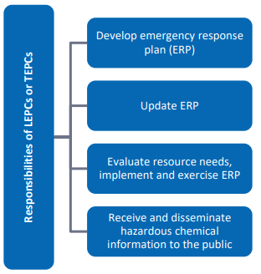
Responsibilities of an LEPC or TEPC:
• Conduct regular meetings to address all pertinent issues.
• Develop and maintain an inventory of known hazardous chemicals.
• Develop and update a hazard/risk analysis.
• Identify private/public sector resources available to deal with hazardous chemical emergencies.
• Develop and periodically update emergency response procedures for off-site emergency response personnel.
• Develop and periodically update emergency warning procedures and evacuation plans.
• Review, process and respond to requests from the public for pertinent information.
• Review, maintain and process all appropriate reports and records as required by law.
• Coordinate training programs on hazardous chemical safety and emergency response procedures.
• Coordinate emergency response exercises.
• Provide expertise and compliance assistance to industries and businesses upon request.
• Educate citizens in the community on what to do during an emergency.
• Receive, maintain and disseminate emerging legislation relating to hazardous chemicals.
Notes:
Before we start let’s take a few minutes and review the responsibilities of an LEPC or TEPC. If you are not an LEPC Community Coordinator, please keep in mind that your Community Coordinator may have multiple duties in their role in Emergency Management and will not have the time or specific expertise to do all the tasks an LEPC requires. During this presentation, please think about what knowledge, skills, and resources you bring to your LEPC and how you can contribute to protecting your community. The most successful LEPCs in Washington have equal engagement among members and share the burden of tasks.
The concept of what an LEPC or TEPC should do is simple. However, when you think about the list of task, this can be a bit intimidating. If you are reenergizing your LEPC, please start small and know you don’t have to do everything at once.
At a minimum, a fully functioning LEPC or TEPC will…
• Conduct regular meetings and have functioning committees. The regularity of these meetings should be indicated in your organization’s bylaws.
• Maintain an inventory of known hazardous chemicals and be aware of additional risk in your community.
• Have a method of regularly conducting chemical hazard and risk analysis and be aware of the private and public sector resources available to deal with these risks.
• Develop and periodically update an emergency response plan with emergency warning procedures, evacuation plans and response procedures.
• Review, process and respond to requests from the public for pertinent information.
• Review, maintain and process all appropriate reports and records as required by law.
• Coordinate a training and exercise program.
• Provide expertise and compliance assistance to industries and businesses upon request. Please keep in mind that we don’t expect any of our LEPCs or TEPCs to know everything about EPCRA and in many cases providing expertise is simply coordinating with State or federal subject matter experts.
• Educate citizens in the community on what to do during an emergency.
• Receive, maintain and disseminate emerging legislation relating to hazardous chemicals.
Reminder to facilitator to ask participants if they have questions:
For our next Section (Susan Forsythe) will go over the Role and Responsibilities of LEPCs and TEPCs

Slide 5
Membership Requirements and Challenges
Notes:
We will start out today by discussing LEPC and TEPC membership requirements and challenges.

Slide 6
Membership Requirements
Per WAC 118-40-160:
LEPC Membership
(a) State and local officials.
(b) Law enforcement.
(c) Emergency management.
(d) Firefighting.
(e) First aid.
(f) Health profession.
(g) Local environmental.
(h) Hospital.
(i) Transportation personnel.
(j) Broadcast and print media.
(k) Community groups.
(l) Owners and operators of facilities subject to the requirements of Section 302(b) of EPCRA.
Chapter 118-40 WAC:
Notes:
Under Washington Administrative code 118-40-160, each Washington State LEPC shall include, at a minimum, representation from each of the groups or types of organizations listed on this slide as specified by Section 301(c) of EPCRA. The link to Washington Administrative Code 118-40 is listed at the bottom of this slide and the full document is also included with the documents you will receive after this presentation.
Optional facilitator engagement questions to participants:
Are there any groups from this list do you have difficultly recruiting into your LEPC?

Slide 7
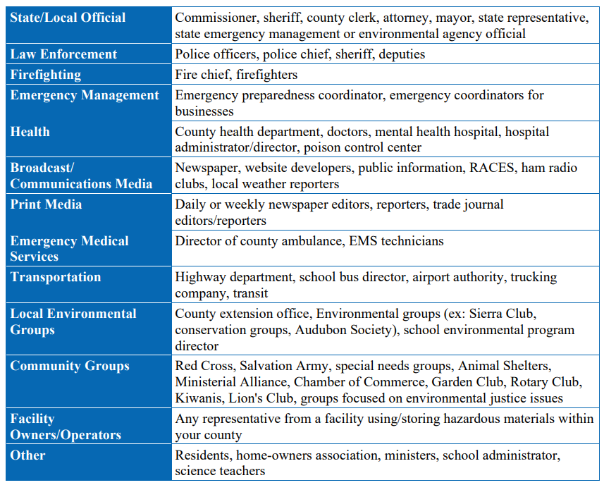
Membership Requirements Continued
Notes:
EPCRA or the Washington Administrative Code does not specifically define each one of these groups. This chart, provided by the EPA, helps define the LEPC Membership roles.

Slide 8
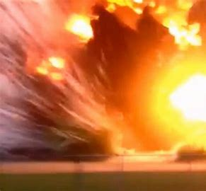
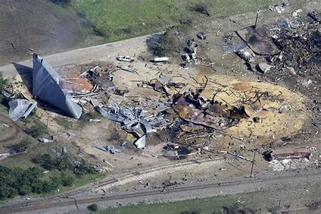
Membership Requirements Continued
Also, per WAC 118-40:
Each Local Emergency Planning Committee shall submit annually, to the state emergency response commission, a list of their membership and the organizations they represent. This can be any roster list that includes names, organizations and email addresses.
The Washington SERC:
To assist you with membership we have an example membership form, sample roster list and sample membership request email.
We suggest the you save a copy of all invitations to potential LEPC members.
Per the EPA Handbook:
“While EPCRA Section 301(c) specifies that each LEPC and TEPC organization should include representatives from each of these groups, EPA recognizes that this is not possible in all communities. Check with your SERC and TERC for guidance on building membership.”
Notes:
Also, under Washington Administrative code 118-40-160, LEPCs must submit a membership list (or roster) to the SERC. This membership list can be in any form as long as it includes names, membership type or organizations and an email address. While it is not required, SERC support staff also encourage you to have your members fill out a membership form. By having an LEPC member fill out this form they are acknowledging that they are a part of the LEPC and are agreeing to task required by their membership. Starting in January 2024, SERC support staff are going to request rosters from each LEPC in Washington. Please let SERC support staff know what they can do to help you with this task. There is a sample LEPC membership form and sample member request email in the EPAs Handbook. We are now asking for these rosters from LEPCs due to a legislative Inquiry to the Military Department, Emergency Management Division on behalf of the SERC received earlier this year. While the request was dropped after several rosters were provided, we acknowledge that asking for rosters during wildfire season was an unfair burden on many LEPC Community Coordinators.
Also, by collecting this information now, we are preparing LEPCs for any future information inquiries or investigations after a major incident. Last year we had a presentation regarding the West Texas Fertilizer Company incident that occurred on April 17, 2013. SERC support staff were surprised to learn that the ammonium nitrate product that exploded during this incident was not on a tier two report to the LEPC. The LEPC still had its planning efforts and membership scrutinized. The two photos you see now are from the West, Texas incident.
We also want to acknowledge that it is very difficult to get representation from each of the groups or types of organizations in your LEPC. Even the EPA acknowledges in the EPA handbook that “While EPCRA Section 301(c) specifies that each LEPC and TEPC organization should include representatives from each of these groups, EPA recognizes that this is not possible in all communities. Check with your SERC and TERC for guidance on building membership.” The Washington SERC just asks that each LEPC do their best to include the appropriate membership in their LEPCs and document all the membership request they send out.
Optional facilitator engagement questions to participants:
By showing a raise of hands, do any of your LEPC or TEPC have members fill out a membership form?
Do any of you want to share your experience on using these forms?
If you would like to share any of the membership forms you use with other LEPCs, please send them to SERC support staff and it will be added to the SERC’s LEPC Toolbox.

Slide 9
Membership Challenges
Finding Specific Membership
For Print and Broadcast Media Representation, try contacting your Local Emergency Communications Committee
Tips for Keeping the Membership Active
Make sure it is clear to membership what they are expected to contribute to the LEPC.
What to do when they don’t show?
Keep a record of the invitation sent to the group or organization.
If necessary, as the SERC for support.
If possible, try similar organizations.
Have members acknowledge their responsibilities to the LEPC by signing a membership form.
Make an effort to make meetings interesting.
Incorporate snacks or a meal into meetings or events.
Notes:
Here are a few of the common Membership challenges that we noticed for our LEPCs in Washington State.
In the LEPC member rosters SERC staff recently collected, there was one group that LEPC membership lacked. This was representation from Print and Broadcast Media. LEPCs across the nation also have trouble attracting these members to their organizations. While we don’t have a firm solution to this issue yet, we suggest that LEPCs contact the counties’ Local Emergency Communication Committee. Has any of the LEPCs participating today tried going though these organizations?
To keep members active, make sure their expectations are clear and they acknowledge them. Try to incorporate an element of interest or maybe incorporate a snack or meal into your meetings or events.
If members or new potential members don’t show up. Make sure to keep documentation that they were invited. If possible, invite a similar organization or ask the SERC for help.

Slide 10
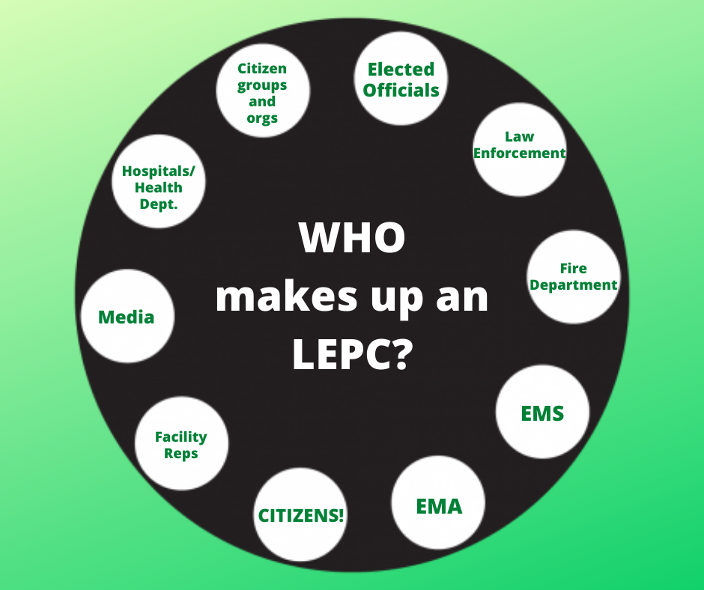
What is required by your Members and Officers?
Meeting attendance
Review Bylaws Annually
Review LEPC Plan Annually
Participate in appropriate Committees
Make sure every member knows that they contribute specific knowledge and resources to the safely of their community.
Your LEPC Bylaws are a great tool to define LEPC Membership Requirements.
Notes:
It is important for each LEPC or TEPC to define what is expected from their members and to acknowledge that each member of the LEPC brings knowledge and resources to the community. Also, you can use your LEPC bylaws as a tool to help define these expectations.
Optional facilitator engagement questions to participants:
Are there any expectations of your LEPC or TEPC member that is not listed on this slide?

Slide 11
LEPC and TEPC By-laws
LEPC or TEPC by-laws should include the following minimum provisions:
• Public notification of committee activities.
• Public meetings to discuss the emergency plan.
• Distribution of the emergency plan.
• Election of officers for the LEPC or TEPC organization.
Additional information that may be contained in the LEPC or TEPC by-laws includes:
• Changes to procedures for emergency response plan.
• Identification of covered facilities.
• Letter to covered facilities.
Notes:
Keeping updated By-laws is one of the best ways to keep the membership of your committee on task Each LEPC and TEPC is required by law to appoint a chair and establish rules by which the committee shall function, including provisions for public notification of committee activities, holding public meetings to discuss the emergency plan, addressing responses to public comments, distributing the emergency plan and designating an official to serve as coordinator for information. In establishing rules of operation, each LEPC and TEPC should consider how it will perform its required duties. LEPCs and TEPCs may reach out to SERC support staff to assist them in developing rules of operation (by-laws). We've included an example by-laws are in the SERC LEPC toolbox.

Slide 12
Meetings and Recommended Subcommittees
Notes:
Next, we will discuss Meetings and recommended Subcommittees.

Slide 13
Requirements of Public Meetings
Per WAC 118-40-170:
Each committee rules shall include provisions for public notification of committee activities, public meetings to discuss the emergency plan, public comments, response to such comments by the committee, and distribution of emergency response plans to the general public.
Notes:
Each of your committee’s rules shall include provisions for public notification of committee activities, public meetings to discuss the emergency plan, public comments, response to such comments by the committee, and distribution of emergency response plans to the general public. The link to the training video is on this slide.
If your LEPC does not have access to a website to host meeting information or share your plan, please let SERC staff know and we can add this information to the SERC webpage. Pleas note the Washington State SERC voted that a redacted version of your plan, omitting contact information for facilities, is acceptable as long as there are directions on how to request the information.
Optional facilitator possible engagement questions to participants:
How had Covid changed the way you meet or interact with the public?

Slide 14
Have an Annual Plan for Meetings and LEPC or TEPC Activities
List of Annual LEPC or TEPC Meetings, Responsibilities and Events:
Meetings
Subcommittee Meetings
Plan Update or Review
Public Outreach Events
Training
Exercise
Tier Two Review
Financial Review
Membership Review
Annual Meet and Greet Event
Notes:
The more you can plan for the year, the more success your LEPC will have in engaging it members and the public. List on this slide are a few annual responsibilities and events to consider. Also remember that your LEPC or LEPC will have to remain flexible.
Optional facilitator possible engagement questions to participants:
Is there anything we left off this slide?

Slide 15
LEPC or TEPC Meetings
Notes:
While LEPCs and TEPCs are required to review the emergency response plan at least annually and this would require at least one meeting, the frequency of LEPC or TEPC meetings is not mandated. Regularly scheduled meetings that address diverse issues and work toward progress on key concerns are essential to maintaining a strong LEPC or TEPC. Listed on this slide are some tips for planning your meetings.
Regular meetings are essential to:
• Address changes in the community (e.g., a new facility that handles hazardous chemicals
began operation).
• Update key phone numbers and contact information of LEPC or TEPC members.
• Ensure that LEPCs or TEPCs are active in their community to review emergency response
plans; review hazardous chemical information reported by facilities in the planning district;
review and/or update emergency response plans as necessary; etc.
Optional facilitator possible engagement questions to participants:
What do you find to be the most challenging part of planning meetings?
Who plans your meetings?

Slide 16
EPCRA Reports
Recommended Subcommittees
Planning
Hazard Analysis
Response Capability
Grant / Financial Resources
Coordinating
Hazard Analysis
Public Outreach
Tier Two and Facility Information
Media Outreach
Notes:
Establishing subcommittees allows for dividing the duties of LEPCs and TEPCs to facilitate planning and data management. Subcommittees create groups for members to specialize and enhance the effectiveness of the emergency planning and response process and allow LEPCs and TEPCs to advance several projects at once. Subcommittees may be formed and disbanded as occasions arise to accomplish initial and ongoing tasks. The number and type of subcommittees depends on the needs of the LEPC or TEPC and its members. Here are a few possible subcommittees for your LEPC or TEPC to consider.
The Planning Subcommittee would be assigned to review, write, and ensure engagement from the whole LEPC or TEPC regarding the plan. This committee could also ensure the collection and review of facility plans.
A Hazard Analysis Subcommittee could lead the process of measuring the risk and resource gaps in the community and share with planning efforts.
A Response Capability Subcommittee could coordinate emergency response capabilities of LEPC member organizations. This subcommittee would also check existing response equipment at facilities and or in the community. This may include drills or exercises to test equipment and responders.
A Grant / Financial Resources Subcommittee would identify and apply for potential grants and other sources of funding.
The Coordinating Subcommittee may coordinate with other LEPCs, the SERC, other states, and Canada.
A Hazard Analysis Subcommittee could lead the process of measuring the risk and resource gaps in the community and participate in the planning process to help fill these gaps.
The Public Outreach Subcommittee would share information regarding EPCRA and emergency preparedness.
A Tier Two and Facility Information Subcommittee would manage information from facilities.
The Media Outreach Subcommittee could engage the media prior to an emergency.
Optional facilitator possible engagement questions to participants:
Does your LEPC or TEPC Currently have established subcommittees
For our next Section (Scott Lancaster) will go over the Role and Responsibilities of LEPCs and TEPCs

Slide 17
Hazard/Risk Analysis
Notes:
An LEPC’s or TEPC’s role in planning is to determine the risk of a chemical incident in their community and how to respond. This can be challenging if the resources to respond to an incident are limited. In this next section we are going to discuss hazard and risk analysis and resource availability challenges.

Slide 18
Know the RISK
• What are the major chemical hazards in our community?
• How can we determine the area or population likely to be affected by a release?
• What emergency response resources (personnel and equipment) does our community need?
• What kind of training do local responders need?
• How can we help prevent chemical accidents?
Notes:
It’s important to know the risk in your area. These are the questions your LEPC or TEPC will be able to answer when you know more about the hazardous material risk in your community.
What are the major chemical hazards in our community and does this include more than tier 2 reports?
How can you determine the area or population likely to be affected by a release?
What emergency response resources (personnel and equipment) does your community have and or need?
What kind of training do local responders need?
How can member of your LEPC or TEPC help prevent chemical accidents? Can your facilities take measure to help prevent incidents how can your LEPC or TEPC provide guidance on prevention?

Slide 19
Hazard/Risk Analysis Tools
Tier Two Reports
Rail Information
Union Pacific UP: Request for Hazardous Commodity Flow Information
BNSF BNSF Hazmat | Commodity Flow Request
Local Knowledge of Additional Facilities
Additional State and Federal Sources
OPA 90
Commodity Flow Studies
19
Notes:
Here are a few tools available to identify the chemical hazards in your community. You should start by looking at your tier two information. Businesses are required to send their Tier Two report to both the LEPC and fire department. This information is also available by request through the Dept of Ecology. If there are facilities in your community that you think should be reporting, you can reach out to that facility and ask them to provide more information or ask the state and EPA for help in making that determination.
Another good resource is the commodity flow information provided by the rail companies. The links to request commodity flow information from BNSF and Union Pacific are on this slide. Side note, the rail companies also provide an application called ask rail This is not a commodity flow report. Ask Rail is more of a tool for responders to use during a rail incident. The next place to look for risk information is in your own LEPC. If you recall from our LEPC 101 presentation, any facility, even if they are not required by EPCRA to report, could be required to provide your LEPC with information for planning purposes. Your LEPC or TEPC has the authority to ask facilities in your community that you deem as having a risk to plan for the risk. In addition to Tier Two facilities, there are laws parallel to EPCRA that require reporting of hazardous materials. Finally, one of the most important sources of information is what's traveling down the roads in your community. In next the slide we will cover road commodity flow studies.

Slide 20
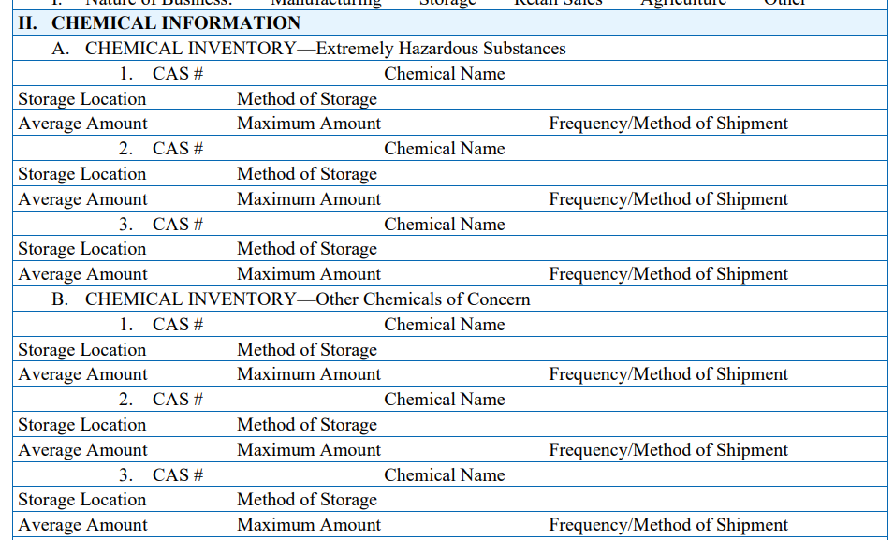
Road Commodity Flow Study
DOT/PHMSA has a guide for conducting hazardous materials commodity flow studies: http://onlinepubs.trb.org/onlinepubs/hmcrp/docs/HM01_FR.pdf.
Notes:
Commodity flow studies are conducted to provide detailed information about the type, quantity, volume, and spatial distribution of hazardous materials traveling through your counties via highways, and rail. For the purposes of this presentation today, we have separated discussing rail information from highway information because it is easy to obtain from the rail companies. The highway or road information is harder, and in many cases, more expensive to gather.
The first method of gathering highway commodity flow information we will discuss will be referred to as the traditional method. This method uses volunteers or paid personnel to observe placards along roadways. The United States Department of Transportation has a guide to conducting traditional commodity flow study information and the link to this guide is on the screen now.
However, recently at a national convention, SERC support staff have noticed examples in other states that SERCs or LEPCs have been asking Tier Two reporters for additional information and have mapped this information as a useful commodity flow study. We will refer to this as the tier two supplemental information method. The EPA has provided a supplemental questionnaire, located in the National LEPC Handbook, that the LEPCs could use to gather additional information from reporters. The screen shot you see on this slide is portion of the questionnaire. The EPA form is optional for LEPCs and not required. If Washington State added a couple extra lines to this form, it would be possible for LEPCs to use this information to contribute to a commodity flow study. The tier two supplemental information method could provide more detailed information on specific chemicals and may not be limited by the time you have to sit by the highway. The additional information on the form would have to include the method of transportation of the chemicals they report, how often they are transported, the addresses and the main route of transportation. This information would be put on a GIS map. However, this picture may not be complete without the information from neighboring counties or states. It would also not include anything that is not reported on tier two reports.
While neither process may be a perfect picture of all the chemical risk traveling down the road, what information that can be gathered helps responders know what training and response resources they will need to respond to an incident on the road. A Commodity flow study is a great way to gather additional information about the risk in your community.
Optional facilitator possible engagement questions to participants:
Is there any interest in Washington LEPCs or TEPCs to modify the supplemental questionnaire provided by the EPA?
Has any of the LEPC in the audience today conducted a commodity flow study? If so, what were the challenges in this process?

Slide 21
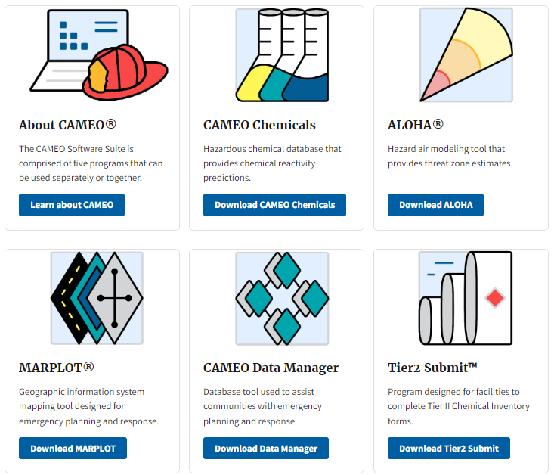
Mapping and Response Tools
Computer-Aided Management of Emergency Operations (CAMEO)
CAMEO | NOAA
E-Plan
https://erplan.net/eplan/home.htm
Notes:
A visual representation of the risk in your community will help you to see the relation of these risk to people and the environment. In addition to any GIS tools that your Local Emergency Management organization may use, Some LEPCs choose to use a subscription-based tool for mapping and response information. However, SERC Support staff can only recommend using the free tool provided by NOAA and the EPA
CAMEO Data Manager Is a tool for managing data about chemicals stored or transported in your community, especially data required under the Emergency Planning and Community Right-to-Know Act (EPCRA).
CAMEO Chemicals: is a program with response recommendations and physical properties for thousands of hazardous chemicals, and it also includes a tool for predicting possible hazards that could occur if chemicals mix. The program is available in several formats, including a CAMEO Chemicals app for iOS and Android.
ALOHA: is a hazard model that estimates how a chemical cloud travels in the air after a spill and identifies areas where a threat to people may exist. It also models some types of fires and explosions.
MARPLOT: is a mapping tool used for assessing geospatial information for emergency incidents and creating custom maps.
We would like to note that Tier2 Submit is not used by Washington state. However, we do send Washington's Tier Two information to E-Plan in Texas to make sure it is available in a CAMEO-compatible format. You can access this information through E-Plan using your First Responder credentials. https://erplan.net/eplan/home.htm
RMP*Comp: is a tool to help facilities complete the offsite consequence analysis that is required as part of the Risk Management Plan.
Online training is available for CAMEO and the SERC is working on providing more in-depth training for LEPCs and TEPCs with limited resources. Also, the department of Ecology can provide tier two information that can be uploaded directly into CAMEO.
Optional facilitator possible engagement questions to participants:
What Mapping tools does your LEPC use?

Slide 22
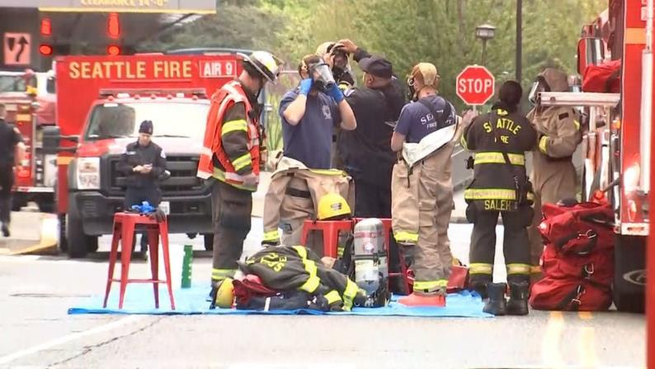
First Responders and the Whole Community
Notes:
In this next section we are going to discuss working and sharing information with your first responders and the whole community.

Slide 23
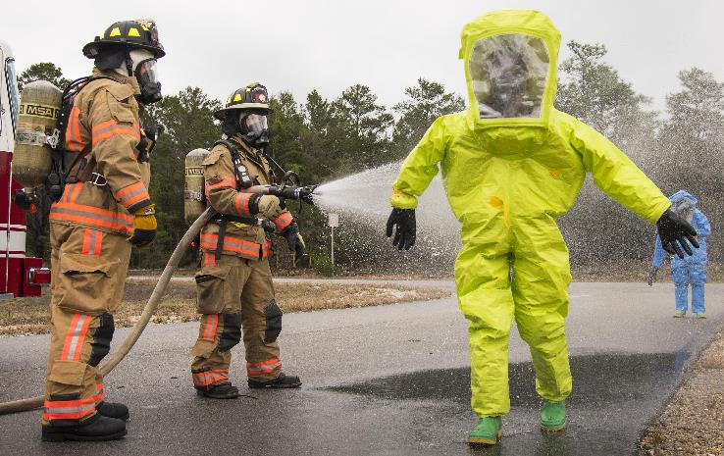
Sharing Information with First Responders
Maintaining a contact list
Strategically planning meeting times to accommodate the first responder in your community
Encouraging participation in exercises
Involving first responders in public outreach
Sharing resource opportunities
23
Notes:
It can be difficult to communicate with all the first responders in your community and to keep their participation. This is a national issue with many LEPCs. This issue could be due to having volunteer firefighters, workload, staffing changes or limited staffing. However, this group is key to the success of your LEPC. Some methods we have noticed have improved participation and kept information flowing include. Maintaining a contact list that includes all first responder agencies and keeping this list up to date. Strategically planning and varying meeting times to accommodate the first responders in your community could be very helpful for volunteers or responders that don’t work a traditional schedule. Encouraging participation in exercises. Involving First Responders in public outreach and sharing resource opportunities such as the Department of Ecology equipment grant.
Optional facilitator possible engagement questions to participants:
How do you keep first responders engaged in your community?

Slide 24
Local Governments Reimbursement (LGR) Program
• Provides reimbursement for temporary, unanticipated emergency measures in response to
hazardous substance releases or threatened releases.
• Provides funds that cannot supplant funds normally provided for response activities.
• Has a $25,000 limit per response.
• Allows only one reimbursement request per incident.
• Does not include petroleum products (unless mixed with another hazardous substance).
Notes:
The Local Governments Reimbursement (LGR) Program is an example of information that should be shared with the whole community including first responders.
In the event of a release (or threatened release) of hazardous substances, EPA may reimburse local governments for expenses related to the release and associated emergency response measures through its Local Governments Reimbursement (LGR) Program. The LGR Program provides a "safety net" of up to $25,000 per incident to local governments that do not have funds available to pay for response actions. This program can provide some financial relief to local governments most seriously affected by costs above and beyond those incurred routinely and traditionally. Key to this regulation (40 CFR part 310) is that reimbursement must not supplant local funds normally provided for response. Because local governments are often the first to respond to an incident to protect the public, EPA created the LGR Program to provide reimbursement to local and tribal governments for certain expenses related to response for hazardous substance releases in their jurisdictions. These funds are limited to $25,000 per single response and are only available if the applying government is not at fault for the release. Requests for reimbursement must be received by EPA within one year of response completion (i.e., when all fieldwork is completed, paperwork is received, and cost recovery is attempted). The goal of this program is to provide financial assistance to government entities that do not have a budget allocated for emergency response and cannot otherwise provide adequate response measures. Contact your state or tribal organization who may have cost recovery statutes for hazardous materials incidents. At a high level, the LGR Program: • Provides reimbursement for temporary, unanticipated emergency measures in response to hazardous substance releases or threatened releases. • Provides funds that cannot supplant funds normally provided for response activities. • Has a $25,000 limit per response. • Allows only one reimbursement request per incident. • Does not include petroleum products (unless mixed with another hazardous substance).

Slide 25
Communicating with your Community
Demonstrate respect for different cultural customs, norms, and gender roles.
Important to maintain honesty and integrity in the process and articulate goals, expectations, and limitations.
Explain technical information in lay terms.
Clearly present information in a way that avoids misunderstandings.
Recognize community and indigenous knowledge.
Conduct community forums in accessible locations and at times accessible for community members.
Leverage non-traditional engagement and communication methods (such as social media).
Encourage face-to-face engagement with community members.
Ensure the availability of translation services to address language barriers.
Notes:
Effective communication with the public can be an opportunity to develop robust emergency response efforts in your community. Relationships thrive and trust is gained when you consider the needs and challenges facing those potentially affected by accidents in your planning district. Local environmental groups, particularly those who are trusted by the vulnerable communities, should be encouraged to join LEPC and TEPC organizations to get involved in planning for chemical emergencies as well as be informed of potential risks of hazardous chemicals present in your community. Such organizations include local advocacy groups and faith-based organizations As members of LEPCs and TEPCs, these citizen and environmental group representatives would be able to assist in explaining potential risks or what to do in case of emergency to the public that may need more assistance. Just as important, as members of LEPCs and TEPCs, these citizen and environmental group representatives can aid committees in understanding the concerns and needs of impacted communities. Please take a moment to read the bullets on this slide.
Engagement questions to participants:
Are there any of these points that your LEPC or TEPC excel at or need more work?

Slide 26
Public Availability of Information
Notes:
EPCRA Section 324(a) states that certain information developed under EPCRA, as well as the reports submitted by facilities under EPCRA, should be available to the public, consistent with Section 322, Trade Secret Provisions. These provisions apply to SERCs, TERCs, LEPCs and TEPCs. As required under Section 301 of EPCRA, SERCs, TERCs, LEPCs and TEPCs should set up procedures and processes for providing information to the community. These procedures may include setting up a reading room and its operating hours, costs for photocopying information, etc.
Section 324(b) of the statute states that LEPCs and TEPCs should publish a notice in local newspapers that the emergency plan, MSDSs (SDSs), and inventory forms are available for the community to review. Such notices shall include the location of the reading room, if established, and the hours of operation. In addition to (or in lieu of) publishing a notice in local newspapers, EPA encourages LEPCs and TEPCs to develop a website for their organization of any activities planned, such as discussion of the emergency response plan, explanation of chemical risks and schedules for emergency plan exercises, etc. LEPCs and TEPCs may also post notices in public institutions, libraries, city hall and other places where the public normally gather or visit. You may also publish fact sheets or brochures to provide to the public. You may request assistance from your state/tribe or EPA.

Slide 27
Release Notification Procedures
Notes:
The notification process for each LEPC or TEPC can be different based on the tools used in that community.

Slide 28
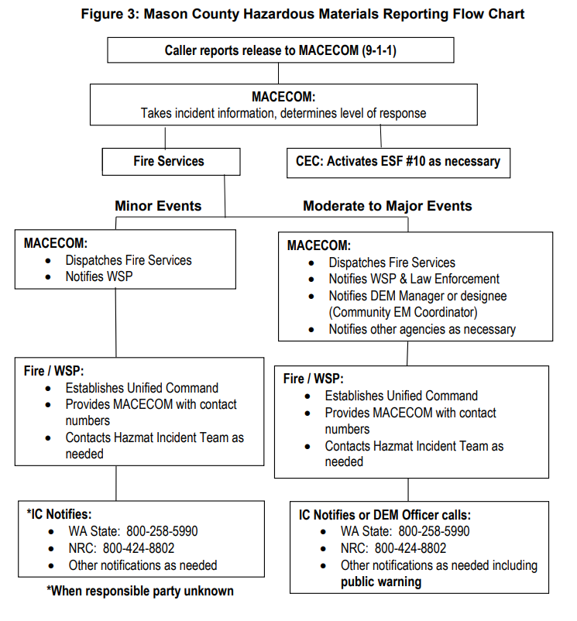
Example: Hazardous Material Reporting Flow Chart
Notes:
One of the most important parts of your plan to test or exercise is the notification process for when a release occurs. We encourage LEPCs and TEPCs to make this very clear in your plan. This slide is an example from the Mason County LEPC plan where the process is clearly defined in a flow chart. Also, please share with your LEPC information regarding the technology and process used in your emergency management office. Please remember that many of your LEPC or TEPC members may not have an emergency management background. If your LEPC or TEPC have not exercised your plan in a while, a short tabletop exercise going through the release reporting process would be a useful activity.

Slide 29
LEPC/TEPC Funding
Notes:
EPCRA is often referred to as an unfunded mandate. In the next section we are going to discuss funding your LEPC or TEPCs activates.

Slide 30
Using a Non-Profit
Notes:
Many LEPCs across the country are now using non-profit associations to support the activities of there LEPC. In Washington we do have a hazardous materials response team supported by a nonprofit that started a couple years ago and will be asking this team for an update on their progress at a future SERC meeting or function. We do have a recorded presentation by this team in the LEPC Toolbox from a previous conference. Creating a 501(c)(3) can take a lot of effort and if your LEPC or TEPC has individuals interested in learning more, please let SERC support know.

Slide 31
Grants
Assistance for Local Emergency Response Training (ALERT) Assistance for Local Emergency Response Training (ALERT) | PHMSA (dot.gov)
Hazardous Materials Instructor Training (HMIT) Grant Hazardous Materials Instructor Training (HMIT) Grant | PHMSA (dot.gov)
Notes:
There are grants available to LEPCs. While I know most of you are aware of grants like the Washington State Department of Ecology Equipment Cashe Grant, hear are a few example of other grants available.
The Assistance for local emergency Response Training grant promotes hazmat response training for volunteer or remote emergency responders. Response activities include the transportation of crude oil, ethanol and other flammable liquids by rail consistent with NFPA standards. The ALERT grant is competitively awarded to non-profit organizations capable of delivering an established curriculum to emergency responders.
Hazardous Materials Instructor Training Grant is a train-the-trainer program that facilitates the training of hazmat instructors who then conduct training in Hazardous Materials Regulations (HMR) for hazmat employees. The HMIT grant is competitively awarded to non-profit organizations that satisfy both of the following eligibility requirements: 1) expertise in conducting hazmat employee training programs and 2) capability of reaching a target population of hazmat employees and including them in the training program.

Slide 32
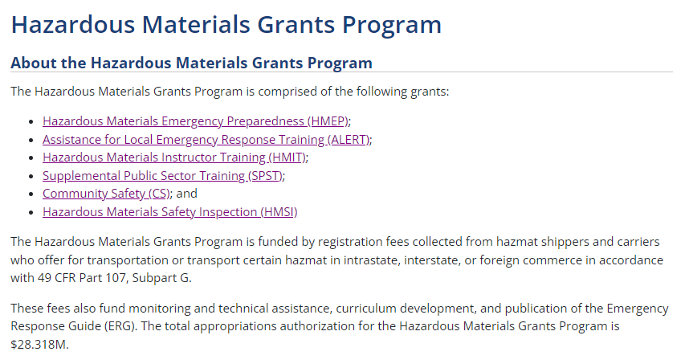
TEPC Funding
Notes:
Grant funds provided by the Pipeline and Hazardous Materials Administration support training and other activities of the Washington SERC. We wanted to take a moment to mention to our tribal partners that the Hazardous Material Grants Program also has funding available directly to tribes.

Slide 33
Priorities and Culture
Notes:
One of the most important factors in having a functional LEPC or TEPC is creating a culture the makes people want to participate and contribute. Washington State SERC support staff have noticed that LEPCs with a more positive and inclusive culture seem to be the most successful in meeting EPCRA requirements. It is completely alright to have interesting meetings, to create exercises that are challenging but don’t frustrate the participants, and plan activities that are educational and fun. Afterall, the work you do is important and interesting. Setting priorities and achievable goals is one of the best ways to engage and keep people interested but please keep in mind that the culture of your LEPC or TEPC is a priority.

Slide 34
Culture
How do you Define the Culture of your LEPC or TEPC?
Notes:
The LEPC or TEPC community coordinator and elected officers play an important part in building a culture for your organization.
Optional facilitator possible engagement questions to participants:
How would you describe the culture of your LEPC or TEPC.

Slide 35
Priorities for your New LEPC or TEPC
Set dates for quarterly meetings for your first year. Include tours or interesting activities for meetings.
Invite membership required by EPCRA.
Start and maintain a contact list and share information on training or other events on a regular basis. Submit this list to the SERC.
During your first meeting:
Cover public meeting requirements.
Cover the basics of EPCRA.
Have an interesting presentation.
Provide a draft by-laws for members to review prior to the second meeting.
Discuss the roles and responsibilities of officers and prepare to vote on officers at a future meeting.
Adopt by-laws at your second or third meeting. Submit a copy of approved by-laws to the SERC.
Vote on officers your second or third meeting.
Start a draft plan using the plan template and create a subcommittee to complete the plan in the first year.
Have your LEPC use the checklist as a tool to determine the priorities of your LEPC or TEPC.
Notes:
Now we are going to switch to discussing priorities of your LEPC or TEPC. Having priorities and accomplishing task is certainly a good way to contribute to positive culture. From the perspective of a SERC support staff member, its impossible for me to define what priorities for your community. However, after our 101 presentation we received a couple comments asking what the priorities of a new or reestablishing TEPC or LEPC would be. So, if I were starting a new committees this is whare I would start.
The EPA self assessment checklist has been developed for the sole purpose of conducting a self-assessment of a LEPC or TEPC organization. It is located in the EPA handbook.
Please see this checklist as a tool you can use to measure the progress ion of your LEPC every year. For established LEPC or TEPCs it is a great toll to measure improvement. If your LEPC or TEPC is just getting started, one glance at a checklist containing 71 items can be a bit intimidating. If you are just getting started, these are the steps SERC support staff would recommend.
Set dates for quarterly meetings for your first year. Include tours or interesting activities for meetings.
Invite membership required by EPCRA.
Start and maintain a contact list and share information on training or other events on a regular basis. Submit this list to the SERC.
During your first meeting:
Cover public meeting requirements.
Cover the basics of EPCRA.
Have an interesting presentation.
Provide a draft by-laws for members to review prior to the second meeting.
Discuss the roles and responsibilities of officers and prepare to vote on officers at a future meeting.
Adopt by-laws at your second or third meeting. Submit a copy of approved by-laws to the SERC.
Vote on officers your second or third meeting.
Start a draft plan using the Plan template and create a subcommittee to complete the plan in the first year. The SERC does not expect this first plan to be perfect. The planning process is continual. You can ask EMD Field Reps for help.
Have your LEPC use the Checklist as a tool to determine the priorities of your LEPC or TEPC.

Slide 36
If you have questions, please reach out to SERC support staff:
Scott Lancaster
Deputy State Fire Marshal
Washington State Patrol/State Fire Marshal’s Office
scott.lancaster@wsp.wa.gov
Diane Fowler
Emergency Planning & Community Right-to-Know Reporting
WA State Department of Ecology
EPCRA@ecy.wa.gov
Susan Forsythe
Washington State SERC Coordinator
Emergency Management Division
Washington Military Department
susan.forsythe@mil.wa.gov
Eastside EMD Field Rep: Pete Hartmann
Phone: (509) 435-6288
peter.hartmann@mil.wa.gov
Central EMD Field Rep: Stephanie Hakala
Phone: (253)298-5446
stephanie.hakala@mil.wa.gov
Northwest EMD Field Rep : David Kelley
Phone: 253-325-3451
david.kelley@mil.wa.gov
Southwest Field Rep: Chris Caprio
Phone: (253) 357-2874
christopher.caprio@mil.wa.gov
36
Notes:
As we finish up our presentation today, we would like to point out the SERC has support staff that can also be a resources to your LEPC.
Reminder to facilitator to ask participants if they have questions:

